Slide 1
Unit Testing
With JUnit

Slide 2
Testing
Testing is the activity of finding out whether a piece of code produces the intended behavior.

Slide 3
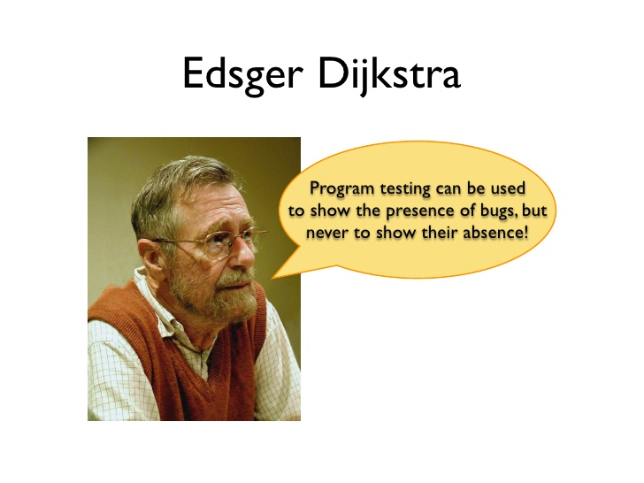

Slide 4
Traditional testing
Test the system as a whole.
Individual components rarely tested.
Errors go undetected.
Isolations of errors difficult to track down.

Slide 5
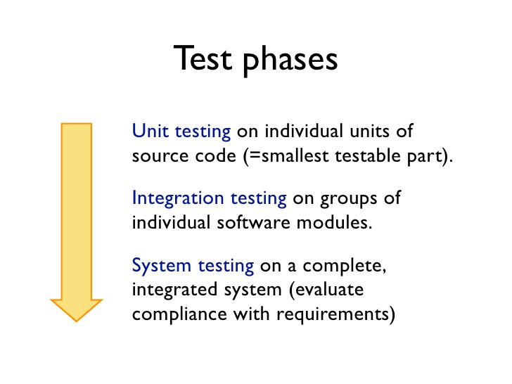

Slide 6
Unit Testing
It is a level of the software testing process where where individual units/components of a software are tested.
The purpose is to validate that each unit of the software works as designed.
Written and run by software developers.

Slide 7

Why Unit Testing?

Slide 8
Why Unit Testing?
Faster development
Faster debugging
Better designs
Excellent regression tool
Reduce future cost.
Easy to refactor
Living documentation

Slide 9


Slide 10
Best practices
Design code with testing in mind. Write tests first.
Keep unit tests small and fast.
Unit tests should be fully automated and non-interactive.
Measure the tests for code coverage.
Fix failing tests immediately.
Keep tests independent.
Name tests appropriately.
Think black-box.
Think white-box.
Test trivial cases, boundary cases too.

Slide 11
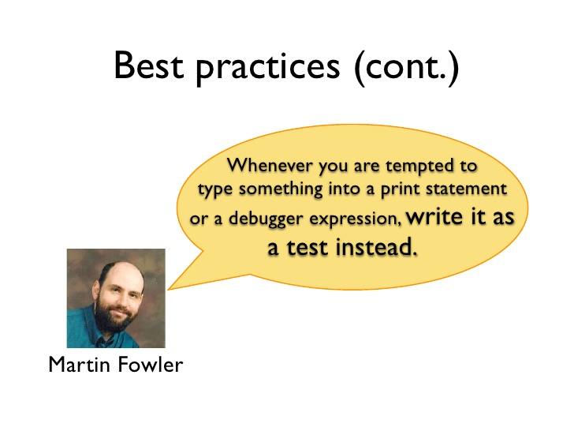

Slide 12
JUnit
A programmer-oriented test framework for Java.
A simple framework to write repeatable tests.

Slide 13
Annotations
org.junit.Test
org.junit.BeforeClass
org.junit.Before
org.junit.After
org.junit.AfterClass

Slide 14
Assertions
assertEquals
assertTrue
assertFalse
assertNull
assertNotNull
assertSame
assertNotSame

Slide 15

A Java framework allowing the creation of test double objects (mock objects) in automated unit tests.
Test double is a generic term for any case where you replace a production object for testing purposes.

Slide 16
Why mocking
Some real objects are very difficult to instantiate and configure.
Sometimes, only interfaces exist and implementations are not even coded.
Database connection, properties file read, file server are some candidates for mocking.

Slide 17
Mocks
Once a mock is created, it remembers all interactions.
Then you can selectively verify the interaction you are interested in.
List mockedList = mock(List.class); mockedList.add(“one”); mockedList.clear(); verify(mockedList).add(“one”); verify(mockedList).clear()

Slide 18
Stubs
By default, for all methods mocks will return a default value or null.
You can stub methods on mock to return the value you would like. when(mockedList.get(0)).thenReturn(“first”); when(mockedList.get(1)).thenThrow(new Exception())

Slide 19
Argument matchers
Mockito verifies values using equals() method
For extra flexibility, you can use argument matchers.
when(mockedList.get(anyInt())).thenReturn("element"); ￼verify(mockedList).get(anyInt());

Slide 20
Verifying invocation count
verify(mockedList, times(2)).add("twice"); verify(mockedList, never()).add("never happened"); verify(mockedList, atLeastOnce()).add("three times"); verify(mockedList, atLeast(2)).add("five times"); verify(mockedList, atMost(5)).add("three times");

Slide 21
Verification in order
Single mock whose methods must be invoked in a particular order.
InOrder inOrder = inOrder(mock); inOrder.verify(singleMock).add("was added first"); inOrder.verify(singleMock).add("was added second");

Slide 22
Consecutive stubbing
Stub with different values/exception for same method call.
when(mock.someMethod("some arg")) .thenThrow(new RuntimeException()) .thenReturn("foo");

Slide 23
Spies
Used to spy on real objects. Real methods will be called unless mocked.
List<String> list = new LinkedList<>(); List<String> spy = spy(list); when(spy.size()).thenReturn(100); spy.add("one"); spy.add("two"); ￼System.out.println(spy.size()); verify(spy).add("one"); verify(spy).add("two");

Slide 24
Capturing arguments
ArgumentCaptor<Person> argument = ArgumentCaptor.forClass(Person.class); verify(mock).doSomething(argument.capture()); Person person = argument.getValue(); assertEquals("John", person.getName());

